Slide 1
Yeezy vs. Off White
Sneaker Resell Value
Kirstie Jones, James Nguyen, Amy Vong, Nicole Zheng

Slide 2
Background
HISTORY
Sneaker collecting is a culture that began in the 1980s with the launch of Nike Air Jordan’s and has since continued to boom and gone global. The trend is especially popular in streetwear and hip-hop culture.
INDUSTRY GROWTH
The sneaker market has really taken off with the growth of online retailers and auction sites. Increased popularity has also meant the emergence of a counterfeit market. In response, sites like StockX and GOAT provide trustworthy platforms for legitimate reselling of authenticated items.

Slide 3
Background: The Designers
Virgil Abloh is an American designer, Artistic Director of Louis Vuitton men’s wear, and CEO for the fashion label Off-White. Off-White is an Milan based fashion company founded by Abloh, with independent designs and collaborations with other brands. In 2017, the company collaborated with Nike and worked on a project named ‘The Ten” which is a sneaker collection featuring different Nike and Converse nineties-styled shoes with various patterns and materials.
Kanye West is an American rapper, producer, and fashion designer. Though prominent in the music industry, West has always made his interest into venturing into the fashion industry known throughout his career. In addition to multiple collaborations and independent designs, West also has a fashion collaboration, Adidas Yeezy, with fashion collaboration between the German sportswear brand Adidas. The collaboration has become notable for its high-end sneakers, and the Yeezy Boost sneaker line has been considered one of the most influential sneaker brands in the world.

Slide 4
What has the biggest effect on resell value?
Hypothesis
Social Media Buzz (Google Trends)
Brand Name
Color way
Size
Geography
Notes:
KJ:
Our proposed questions:
Is there a correlation between social media influence and sneaker resell value?
Is there a correlation between resell value and shoe size?
Is there a correlation between resell value and color way?
Is there a correlation between social impressions and resell value or velocity of buy?

Slide 5
StockX
2019 contest offering prizes for the best visualizations of this dataset
Data contains information on Yeezy & Off White sneakers
Google Trends
Used as proxy for social media buzz in lieu of historic social media API data
We restricted the data to match our StockX timeline (Sept 2017 – Feb 2019)
Data Sources
Notes:
Our starter data came from Stock X. They are a “live/ask bid website” that held a contest last year and offered prizes for the best visualizations of the given data. The data contained information on Yeezy and Off White sneakers including their original sale price, resell value, size, color way, and buyer state from Sept 2017 to February 2019. We used Google Trends as a proxy for social media buzz in lieu of access to historic social media API data.

Slide 6
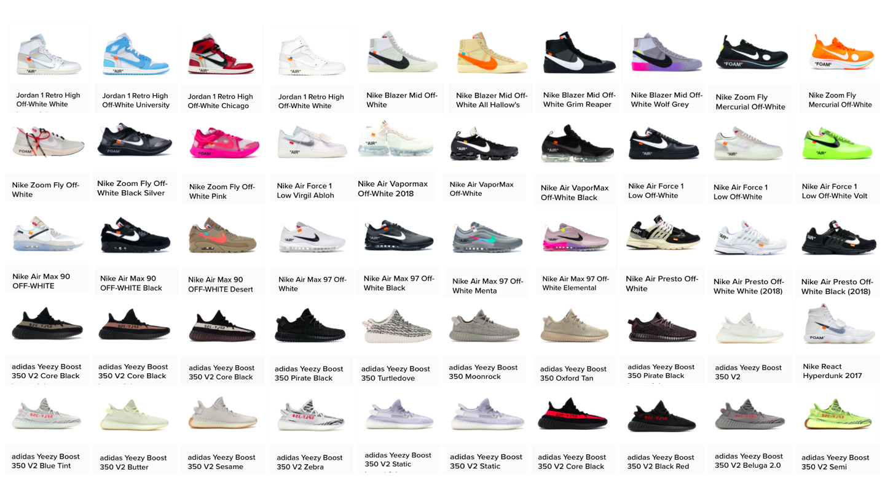
We observed:
11 shoe types
50 different color ways (i.e. colors)
Each color way had different available units, launch dates, & retail pricing
Notes:
KJ: We observed 11 shoe types in 50 color ways. Each color way had different available units, different launch dates, and retail pricing.

Slide 7
Methodologies
Shoe sales data was analyzed along groupings of:
sneaker type (eg. Air Max 90s, Yeezy Boost 350s, Air Force 1s, etc)
sneaker colorway
Brand
geographic buyer distribution
Google Trends data was pulled for brand searches on a state level and national level

Slide 8
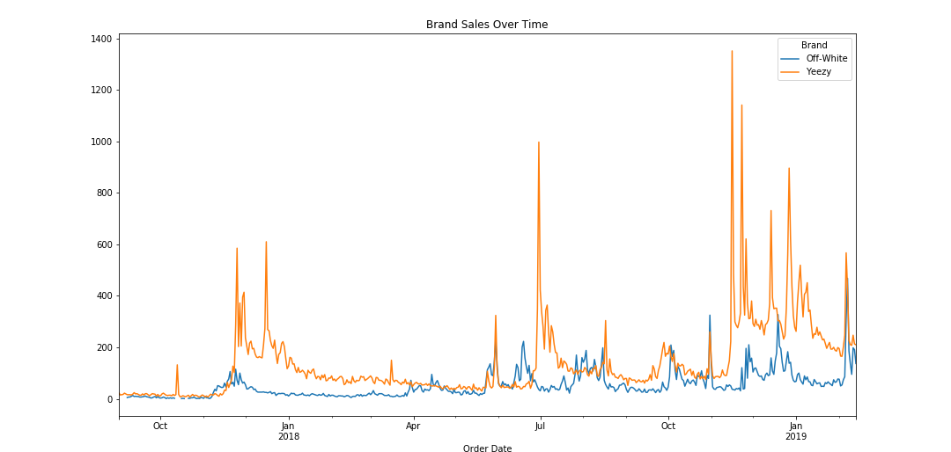
Analysis: Brand Name vs Resell Value
We wanted to analyze sale trends between the 2 brands over time to see if there were any spikes during certain times of year, as well as compare the brand sales ($)
Notes:
KJ: This graph shows a breakdown comparing the 2 brands (Yeezy and Off White) and tracks the sales over time.

Slide 9
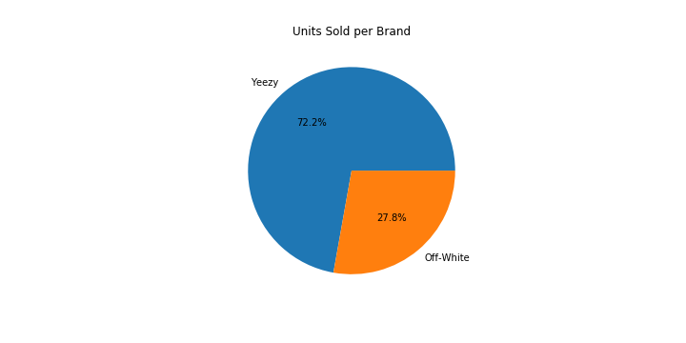
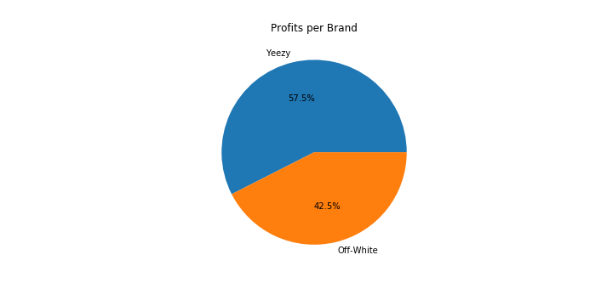
Analysis: Brand Name vs Resell Value
In analyzing the 2 brands, we examined both how many shoes were sold, as well as $ to dig into the popularity and resell worth
We were surprised to find that, although Yeezy sold more units, Off White resells were more profitable
Notes:
KJ: We were surprised to find that even though Yeezy sold more units, Off White resells had more profitability

Slide 10
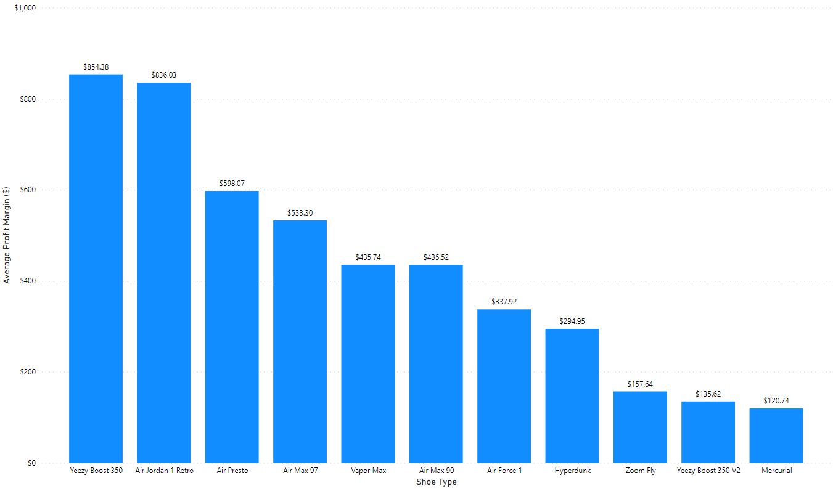
Avg Money Made Reselling
Analysis: Brand Name vs Resell Value
Within the 11 shoe types, the original Yeezy and Jordan 1s were the most successful in terms of average resell $, even though the original Yeezy Boost only has 4 colorways and the Jordan 1 has 3 colorways
Notes:
AV:

Slide 11
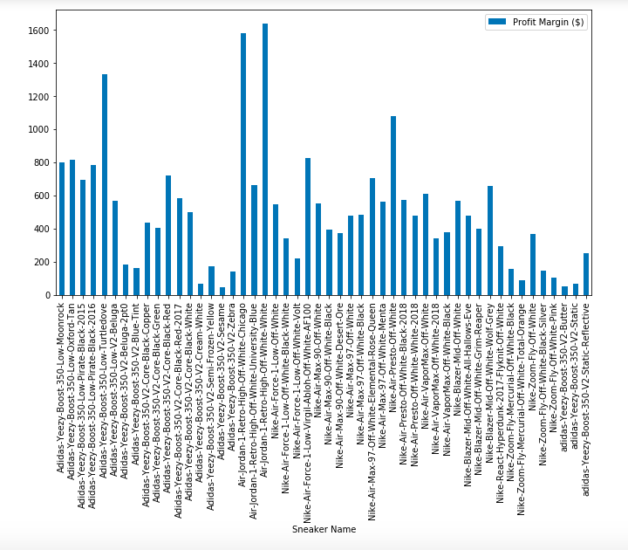
Resell $ By Color Way
In respects to colorway, this viz shows profit % and colorway. With the exception of the Jordan 1 Off-White White, the colorways per shoe type share similar profit % regardless of colorways, suggesting the colorway may not correlate to a higher resell. But shoe type and Brand value/recognition may serve as a stronger correlation to higher resell.

Slide 12
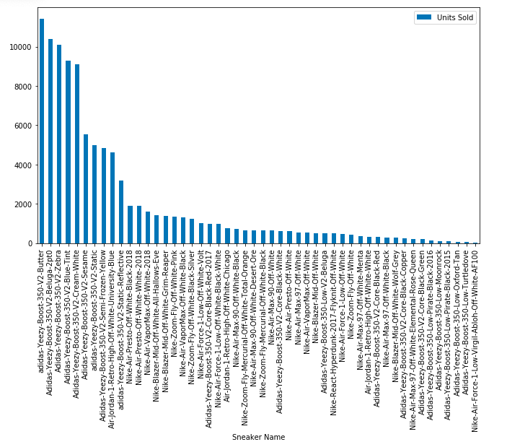
Analysis: Units of Colorway Sold
Sneaker Units + Color Way Sold
This bar chart represents the amount of units sold per colorway in each shoe type
As demonstrated on the chart, some of our highest profitable shoes have the least units sold
This suggests that the value of the shoe make correlates to the “scarcity” of the units available
Notes:
AV:

Slide 13
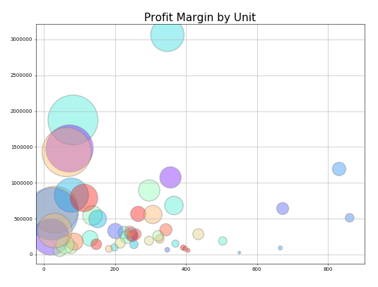
Notes:
AV

Slide 14
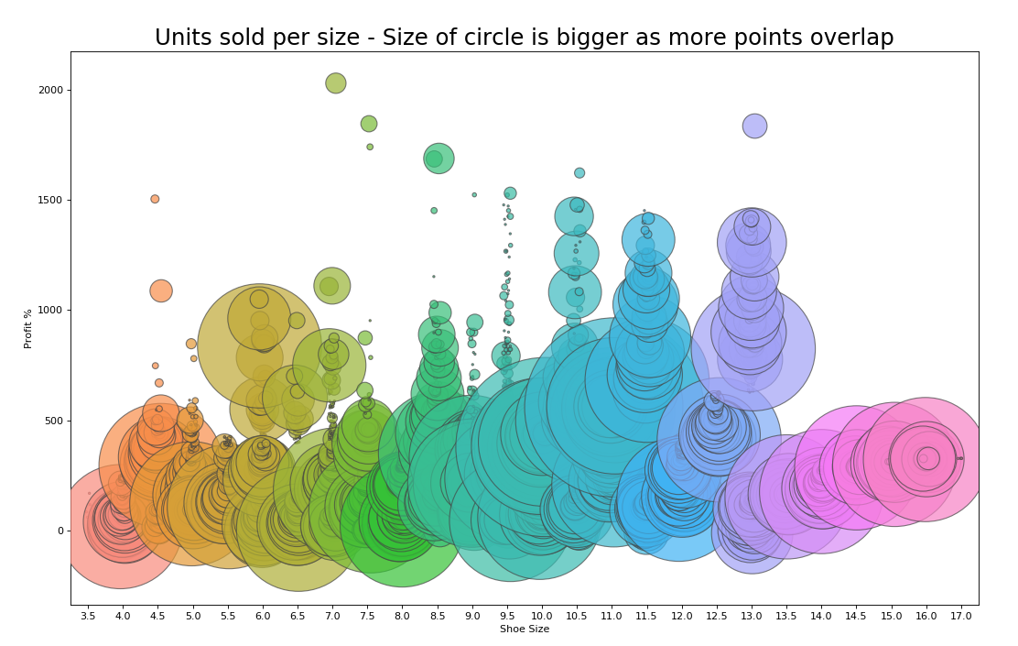
Analysis: Shoe Size vs Resell Value
An examination of all the shoes sold in the dataset shows the bigger the bubble, the more units sold in that size
This reveals the correlation between shoe size & resell value, the most common shoe sizes (9-11) have the highest chance of reselling at a high value
Notes:
KJ: Correlation b/t resell and sizing
Representation all of the shoes sold in the dataset. The bigger circles show that there are more units sold in that size. You can see from this, if you purchase a size 9-11, you stand the highest chance of reselling at a high value.

Slide 15
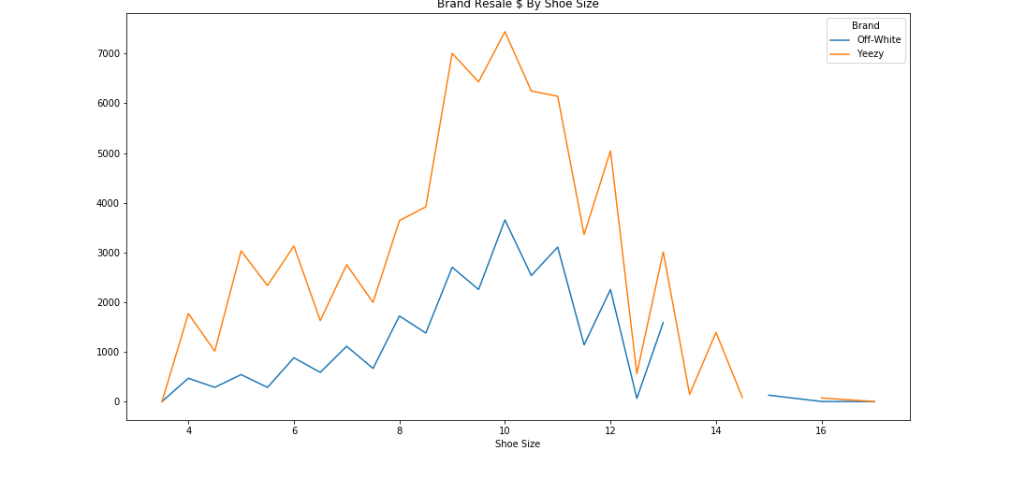
Analysis: Shoe Size vs Resell Value
Breaking down the 2 brands and examining the correlation between shoe size and resell value shows the same spike around the common sizes 9-11
It also reveals that Yeezy is much more dramatic in the difference between the resell value of size 11 vs 14. Off White is more consistent in value across the sizes.
Notes:
KJ: This chart matches the bubble chart above, showing the same spike in shoe size with resell value. And that spike represents how common having size 9-11 shoes is.

Slide 16
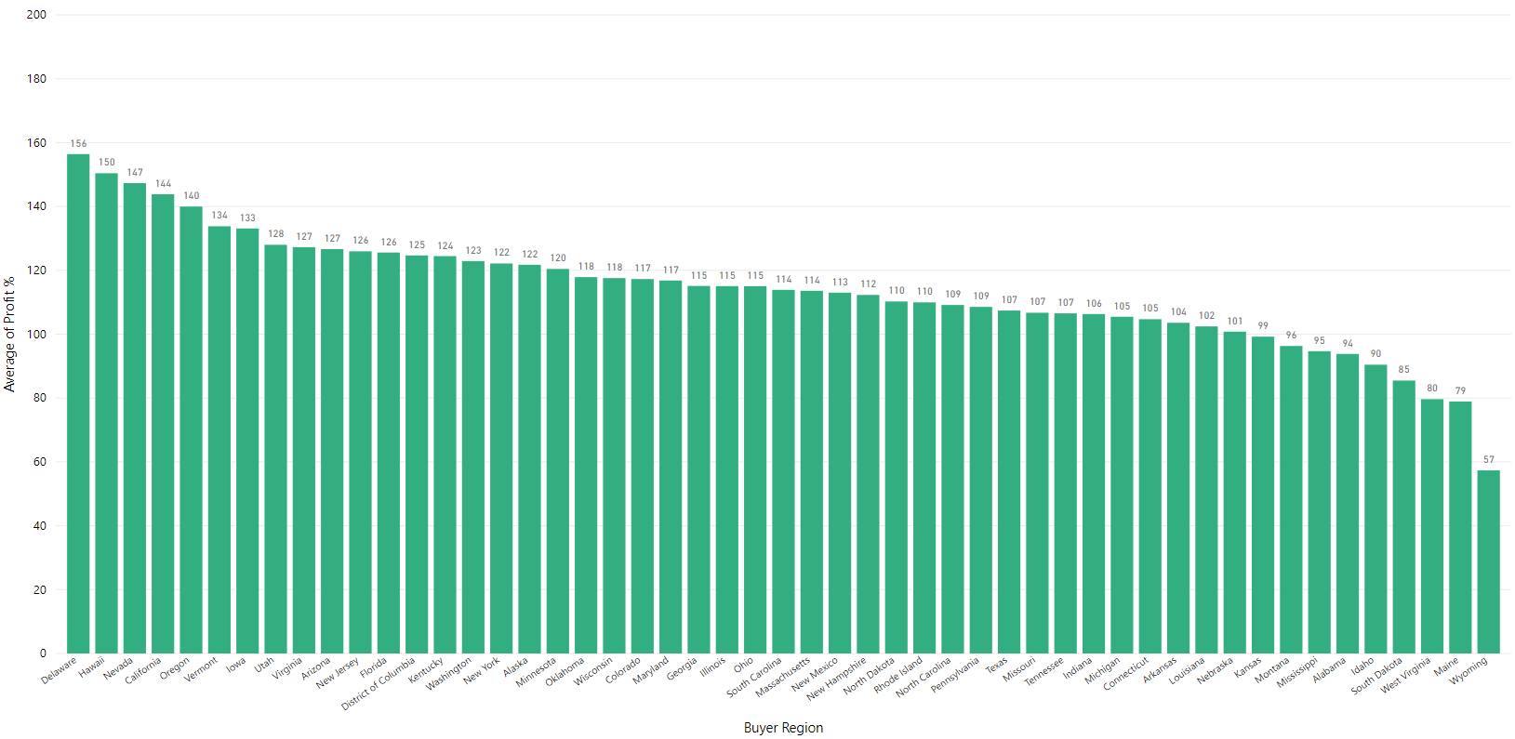
Avg Profit Margin % per State
On average, people made profit no matter what shoe and where it was sold
However, people saw greater margins of profit selling to different geographic areas that lined up with our expectations of observable trends:
Biggest profits were in:
Regions of higher population density
Regions known to be drivers/innovators of sneaker culture
Lowest profits were in areas of lower population density
Notes:
JN

Slide 17
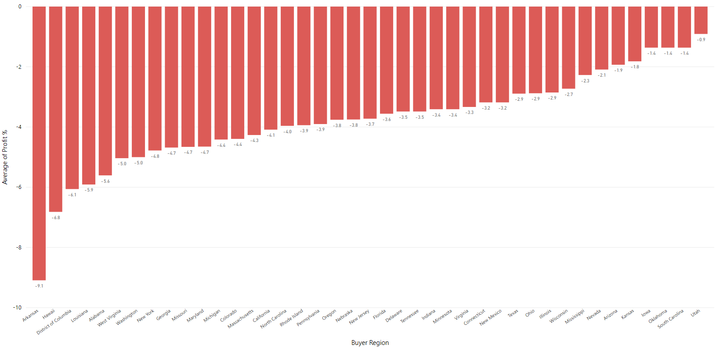
Avg Loss Margin % per State (where applicable)
When looking at the data, there were inevitably going to be people who lost money trying to re-sell
After slicing data for loss margins, only shoe brand that experienced any losses at all were Yeezy Boost 350 V2s
Geographic distribution of losses lined up with our expectations as well
Biggest losses typically in states with higher volume, more competition for resales
High variability in both extremes of high sample size and low sample size states
Despite that, loss margins were on average relatively low
When you win, you win big & when you lose, you lose small
Notes:
JN

Slide 18
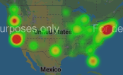
Volume of Dollars Spent in US
Visualizing the volume of dollars spent on sneaker re-sales, we saw 3 major zones of activity:
Eastern Seaboard
California
Oregon
These 3 markets have the biggest volume of sales and the most $ velocity, which reinforces the importance of these markets as cornerstones of sneaker culture AND marketing targets
Notes:
JN: Top 5 states that spend the most money

Slide 19
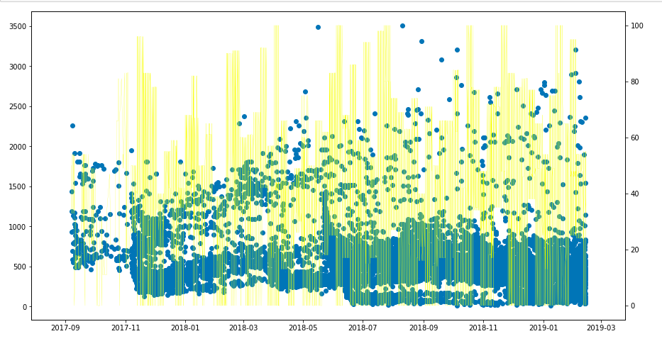
Off White Sales vs Social Media Correlation (Top 5 States)
When charting the Google Trends scores for “off-white” vs sales data, we noticed a slight correlation
Generally, Trend scores remained high overall
Spikes in Trend scores tended to line up with sale price spikes
Notes:
JN

Slide 20
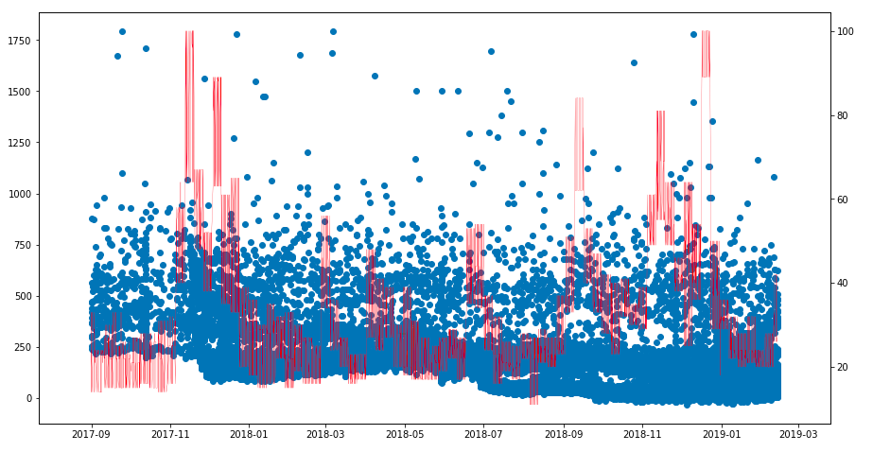
Yeezy Sales by Social Media Correlation (Top 5 States)
When charting the Google Trends scores for “yeezy” vs sales data, we noticed a lesser correlation
Notes:
JN

Slide 21
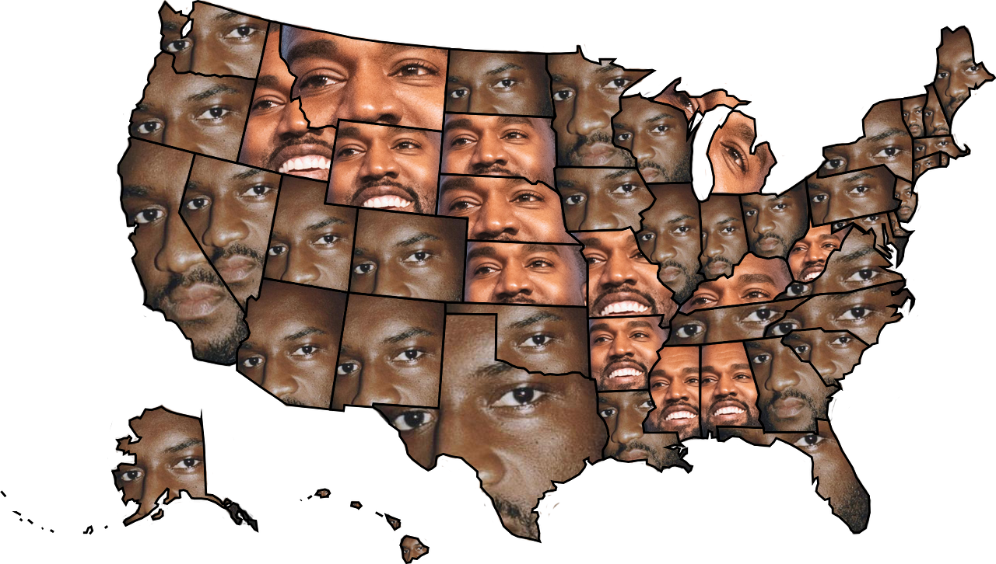
Ye-nited States of Virgil
In the spirit of the upcoming presidential election, we wanted to see who would win the cultural battle for America's Top Designer
People say "Money talks", so we used sales dollars to represent votes
Virgil won a plurality of both number of states and populous states, so Virgil Did It Again™
Notes:
JN: Who sold the most in each state – Off White or Yeezy?

Slide 22
Conclusion: Regional Impact
In cities where there are bigger populations and regions where sneaker culture and fashion are prevalent, higher volumes of sneakers will be bough from those areas

Slide 23
- Off-White the brand is more popular across the board than the Yeezy brand was in this dataset. - There is a small correlation between resell value and colorway but a stronger correlation is within the resell value and shoe type/brand suggesting that brand value is more valuable than colorway.
Conclusion: Brand Value vs Colorway

Slide 24
- Limited quantities in shoes correlate to a higher resell % suggesting that “scarcity” can contribute to higher resell value and profit. - Size can correlate to resell, specifically 9-12.5 with the most profitable size at a size 10. The data suggests that regardless of shoe type or colorway, a profit will still be made in those sizes
Conclusion: “Scarcity” and sizing

Slide 25
- Social media “buzz” for Off-White within the date range of this dataset trended consistently and high over time. The sale of the shoes remained consistent with sell through and contained several outliers in resell price so it did not strongly support that social media buzz and impacted the Off-White sneakers. - Social media “buzz” Yeezy had spikes that did not correlate with the purchase dates so it also did not strongly suggest that social media buzz had an impact of resell or purchase value.
Conclusion: Social Media”Buzz”

Slide 26
Data Limitations & Other Considerations
Google Trends scores:
Imperfect measure of social media buzz, mostly due to the potential for “signal noise”
“Yeezy” is both a brand name and a nickname for Kanye West himself, so spikes in activity could be due to unrelated reasons to sneakers
“Off-White” is a fairly common color, so data in general could be due to unrelated searches for the color itself rather than the brand
Access to API resources:
An enterprise level API license for true social media scrapes like Twitter or Instagram could bear more fruit for historical trend analysis
Focus searches in an around sneaker release dates or other important news related to the brand
StockX source data:
Only included basic geographic data
Would’ve been interesting to see a deeper analysis based on zip, county data
Only 2 brands, 50 color ways
Analysis of more brands and more types of shoe in the re-sale market

Slide 27
Q&A
Notes:
Since social media mentions doesn’t have a strong correlation to resell value, we have found that size, scarcity, region has a stronger impact on the value the sneaker holds in the market.

